Slide 1



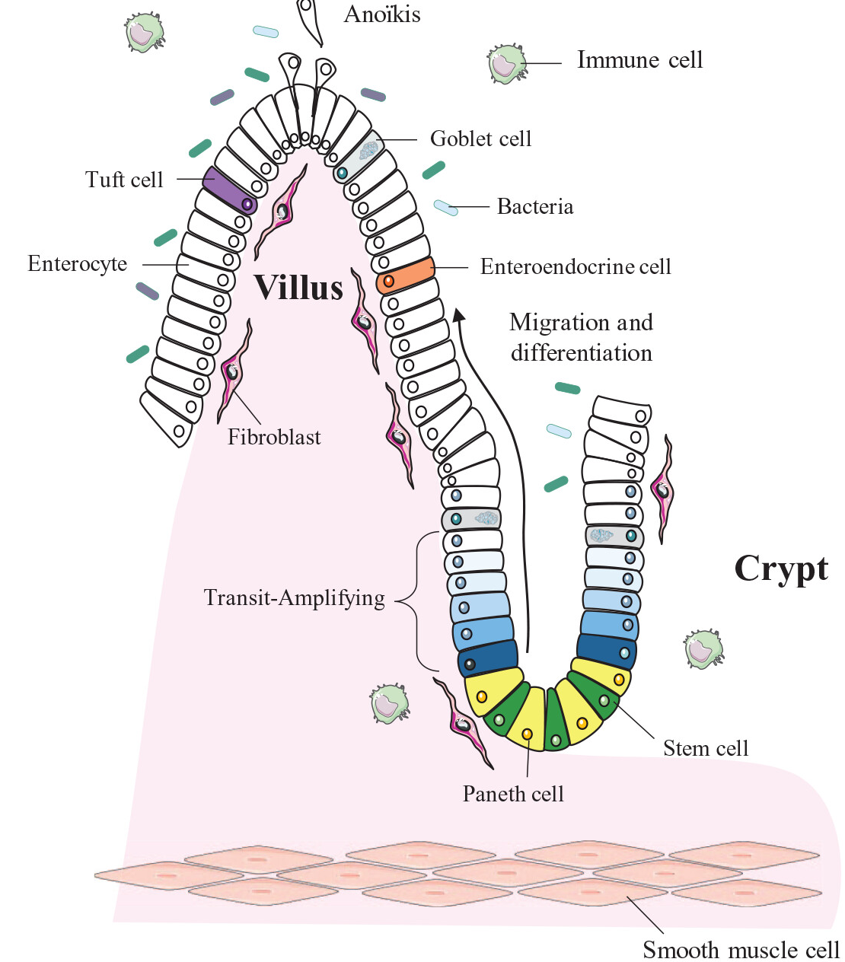
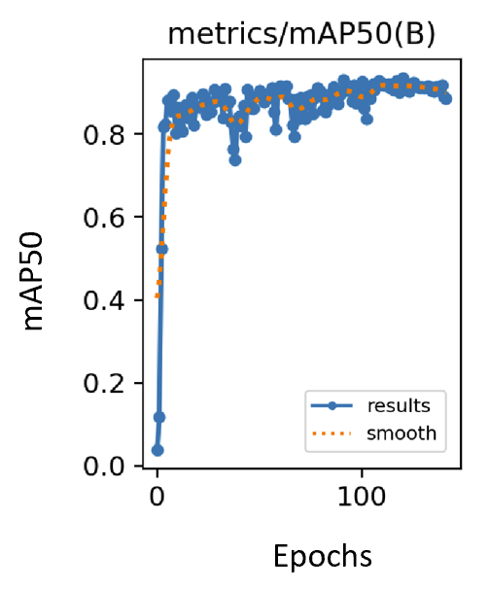
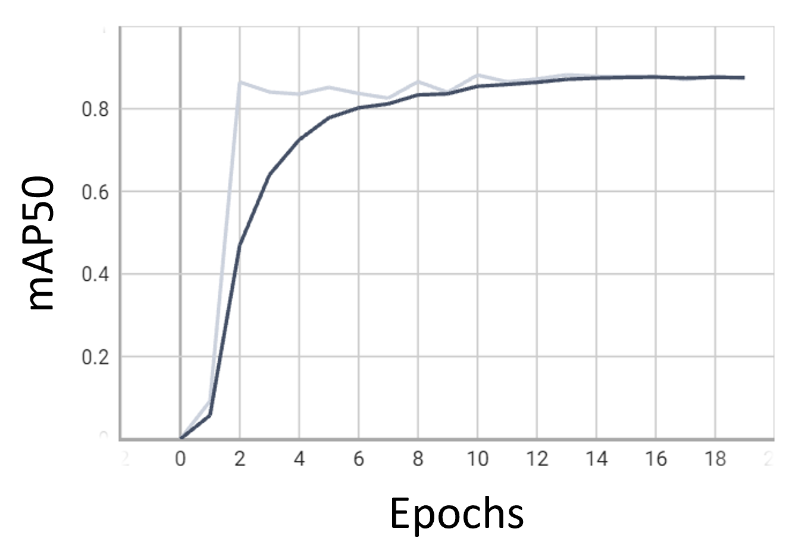
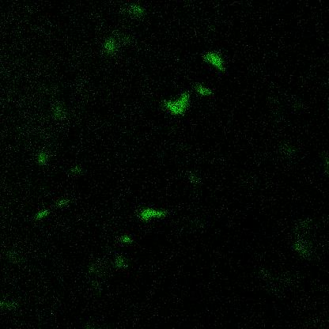
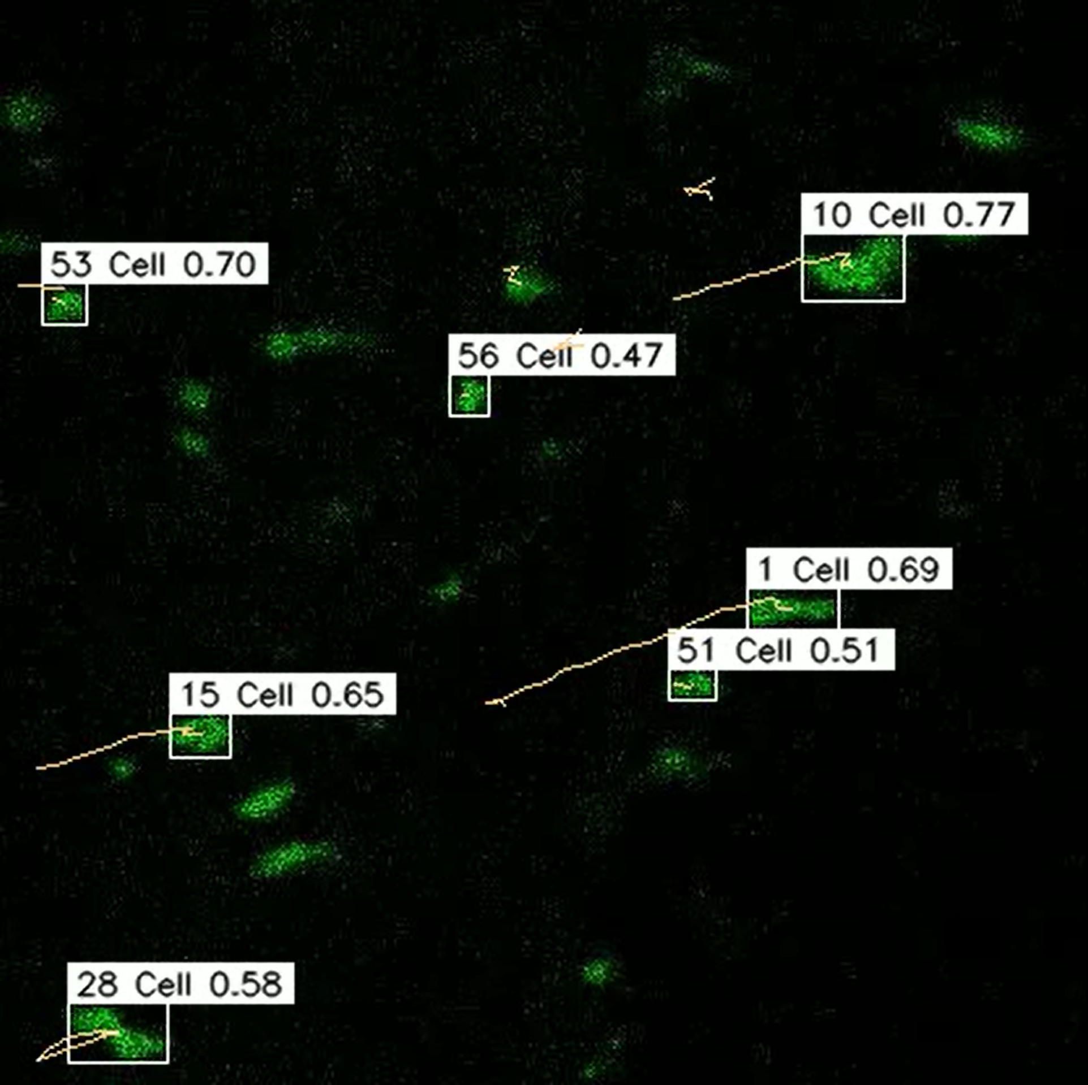
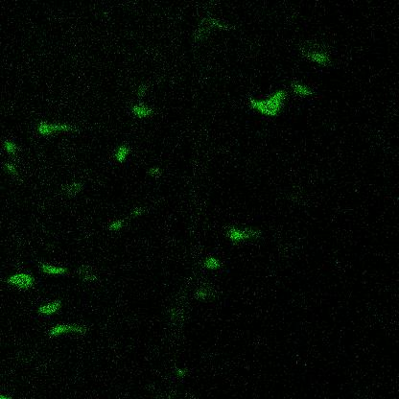
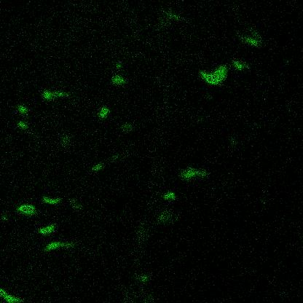
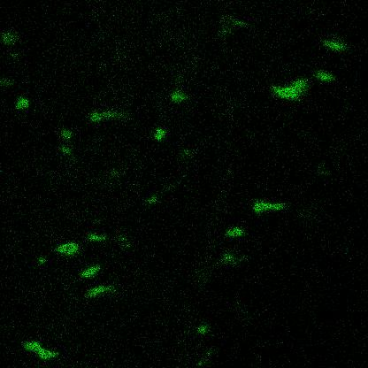
Deep Learning based methods to understand signalling dynamics in Intestinal Stem Cells (ISCs)
Name: Yash Borikar | Supervisor: Dr Deepayan Bhowmik
School of Computing, Newcastle University
Introduction
Methodology
Results
Understanding the biological processes of intestinal stem cells (ISCs) is crucial. ISCs can regenerate themselves in crypts and develop into specialized cell types including enterocytes, goblet and Paneth cells in the intestinal epithelium. Studying cell migration can help researchers to understand signal dynamics, especially the Ras/MAPK pathway that governs stem cell fate determination and proliferation.
The methodology to detect intestinal stem cells in a series of frames is carried out in three stages.
Stage 1: Data preparation which includes extracting frames from the Dataset file (.liv format) and preprocessing each frame and annotating data to make it suitable for the object detection models.
Stage 2: Implementing YoloV8 [1] object detection model for precisely detecting cells in each frame. The selection of the YoloV8 model is motivated by its rapid processing capabilities and comparing performance with other models trained on this given dataset. YoloV8 was finely hyperparameter tuned and trained on annotated data to understand discriminative features and spatial relationships of ISCs from the background ensuring precise detection under varying conditions of ISCs in terms of size, shape and orientation. The results emphasize the outstanding efficiency of the YOLOv8 model in precisely identifying cells in video frames. The model's capacity to precisely identify ISCs is validated by the mean Average Precision (mAP) of 50% IoU threshold scores. Precision-recall curves and confusion matrices are also used as evaluation parameters to compare models performance.
YOLOV8 performs better than YOLO-NAS in detecting cells for the given dataset with a higher mAP50 value of 90.20% compared to YOLONAS 85.50%.
Detection Models | mAP50 (%)
YOLOV8 | 90.20
YOLO-NAS | 85.50
Table 1: Comparison mAP50(%) values of Object Detection Models
Fig 1: The intestinal epithelium
Aim
The study aims to develop advanced deep-learning algorithms that can precisely detect and track intestinal stem cells within a series of consecutive frames that procure cell migration over time intervals. The focus is on observing the cell's movements and collecting relevant data for subsequent analysis. This research will aid to improve comprehension of ISCs and their behaviour, ultimately contributing to the advancement of scientific knowledge in this field.
Kalman Filter
Fig 6: mAP50 – YoloV8
Fig 5: mAP50 – Yolo-NAS
YOLO-V8
BYTE
Hungarian Algorithm
Discussion
Dataset
Input Video Sequence
Object Detection
Multiple Object Tracking
Tracking Results
Evaluation
Compared YOLOV8 and YOLO-NAS object identification models, focusing on their mAP50 accuracy of 50% IoU threshold, YOLOv8 outperformed YOLO-NAS in ISCs recognition and ByteTrack exhibits more accurate outcomes
The dataset consists of 10 videos depicting the movement of Intestinal Stem Cells, with each video containing frames captured at different time intervals over a span of up to 2 hours. The resolution of each video in the dataset is 416 x 416 pixels.
Fig 3: Detection and Tracking Algorithm Architecture
Stage 3: Integrating object Detection model (YoloV8) with ByteTrack [2] Algorithm, this allows accurately detecting ISCs with high confidence in every frame of the video. Kalman filter is used to predict the new locations of the detected ISCs in the current frame further applying the Hungarian Algorithm to filter for matching based on similarities which together are integrated in ByteTrack Algorithm. Finally, motion trajectories of the high-confidence ISCs detections are depicted in each frame of the output video and the instance of results are illustrated in Fig 4, which helps researchers better understand the signalling dynamics of ISCs.
Future Work
Integrating Object Detection Models with other Tracking Algorithms like DeepSORT, StrongSORT.
References
Jocher, G., Chaurasia, A., & Qiu, J. (2023). Ultralytics YOLOv8 (Version 8.0.0). [Software] https://github.com/ultralytics/ultralytics
Zhang, Y., Sun, P., Jiang, Y., Yu, D., Weng, F., Yuan, Z., Luo, P., Liu, W., & Wang, X. (2022) ‘ByteTrack: Multi-Object Tracking by Associating Every Detection Box.’ arXiv:2110.06864 [cs.CV].
Fig 2: Sample frames from Dataset (Directional Arrow Annotations for Cells Movement Visualization)
Fig 4: Detected Cells Trajectories: Image Annotations and Tracking

Slide 2
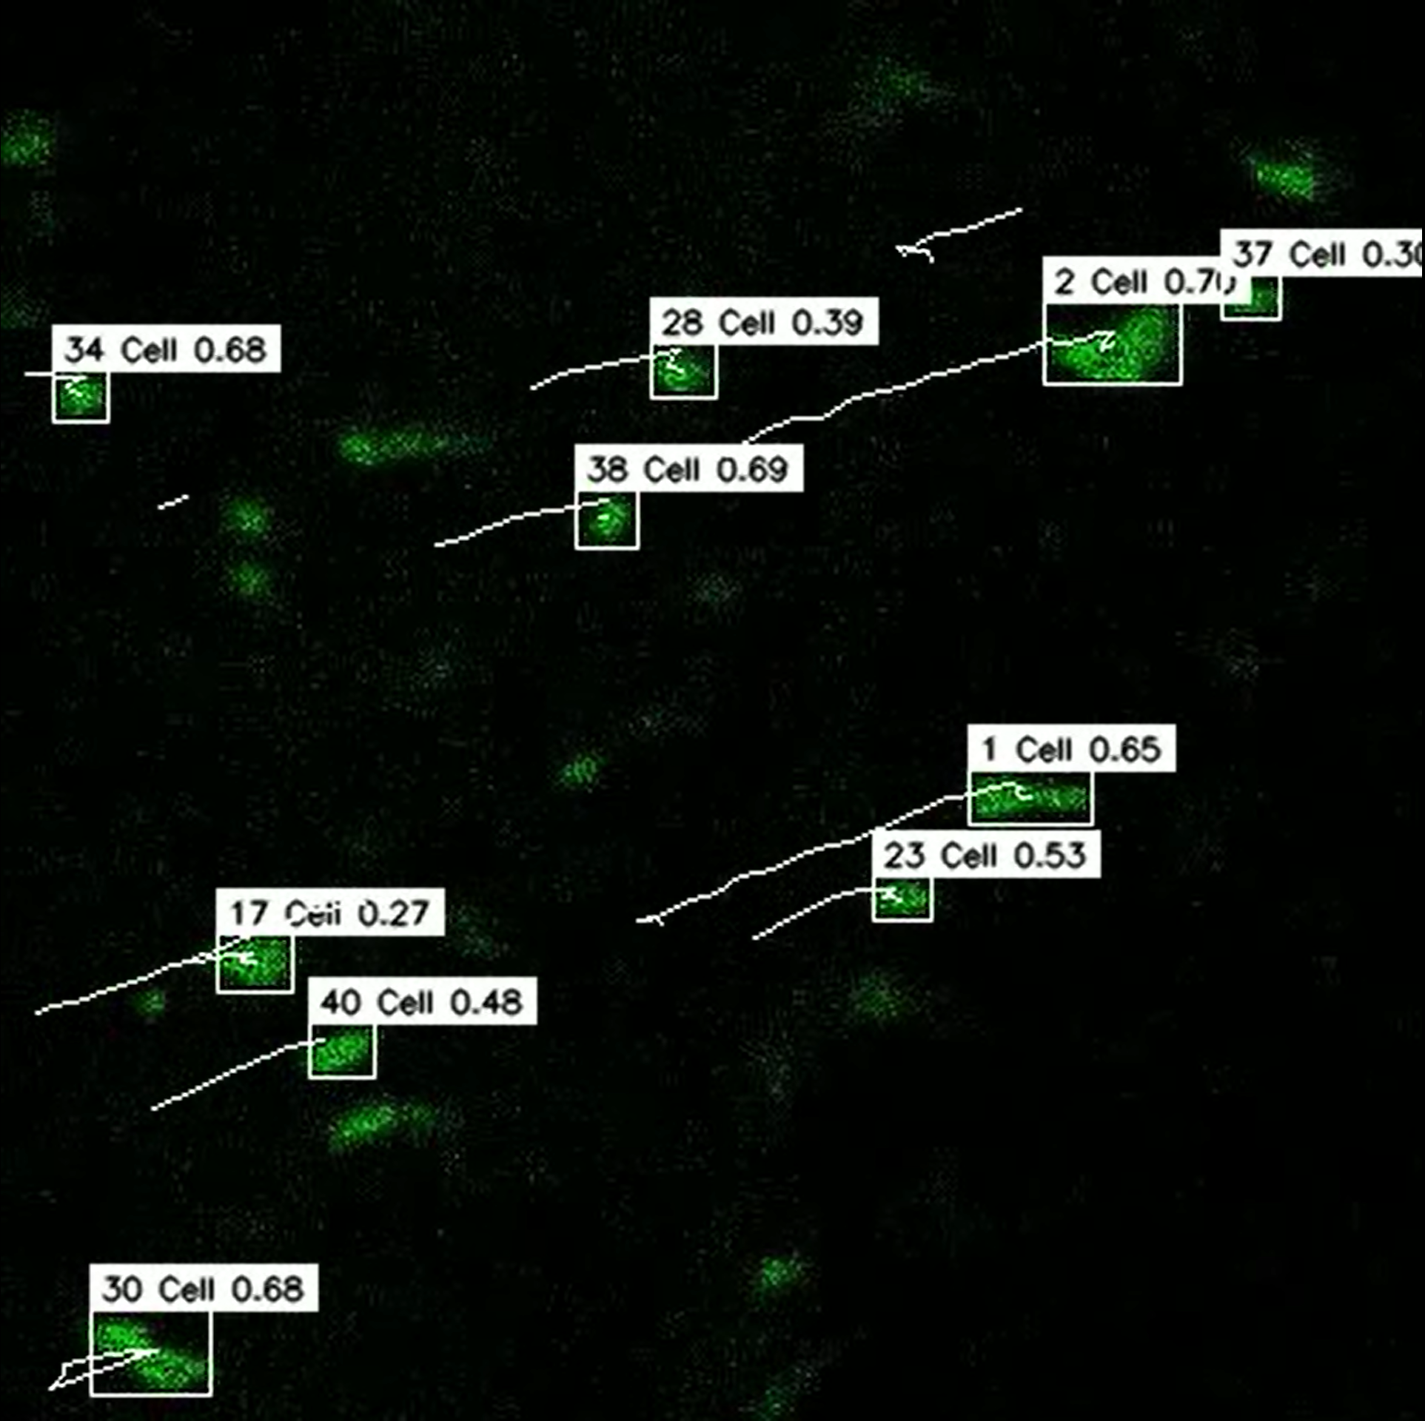
Kalman Filter
YOLO-V8 [S, M, L] / YOLONAS [S, M, L]
Best Model
BYTE
ALGORITHM
Hungarian Algorithm
Input Video Sequence
ISCs Detection
Multiple ISCs Tracking
Tracking Results

